Slide 1
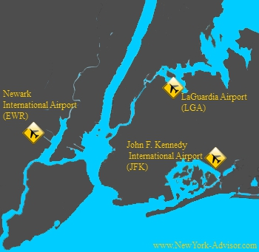
NYC Flight Data Analysis
Date : 20.06.2020
The New York region is one of the most congested aviation region in the United States. It has 3 main NYC airports (Kennedy-JFK, LaGuardia-LGA, and Newark-EWR) . In 2013 , 4000 + aircrafts covered 328521 flights from these airports to across the country and overseas landed at 105 destinations.
Presented by Renuka Sachdev

Slide 2

Background & Problem statement
Flight delays have been a significant problem for the New York region for many decades due to the various factors –
A small and densely occupied airspace.
Limited capacity among the region’s three main airports.
Continued growth in air traffic.
In 2013 , NYC’s 3 Airports led for flight delay in United states with close to 40 percent of arriving flights either delayed or cancelled. Such delays not only pose a significant problem for air travelers but also affect passengers flying to other parts of the region.
We will analyse the pattern and conclude the main areas for delays and suggest actionable insights.
Source: US Dept. of Transportation Memorandum 2010
NYC Flight Data 2013

Slide 3
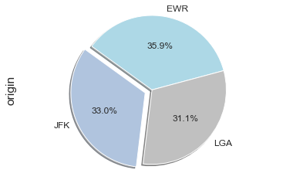
NYC 3 Airport’s flight contribution in %
NYC – 3 Airports have managed 328521 flights in 2013
Newark has managed 35.9% flights followed by Kennedy JFK (33%) and LGA (31.1%)

Slide 4
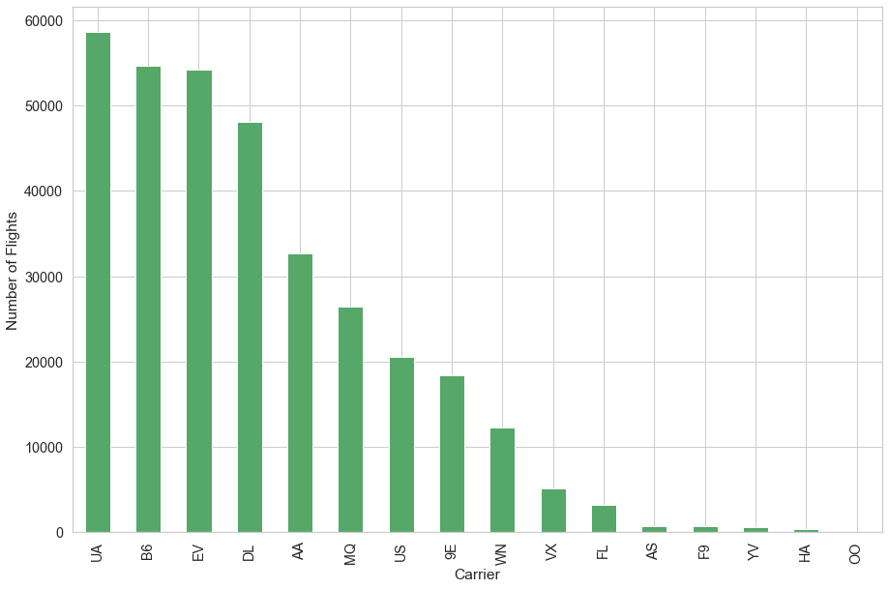
Top Carriers being operated from NYC Airports
9E: Endeavor Air Inc.
AA: American Airlines Inc.
AS: Alaska Airlines Inc.
B6: JetBlue Airways
DL: Delta Air Lines Inc.
EV: ExpressJet Airlines Inc.
F9: Frontier Airlines Inc.
FL: AirTran Airways Corporation
HA: Hawaiian Airlines Inc.
MQ: Envoy Air
OO: SkyWest Airlines Inc.
UA: United Air Lines Inc.
US: US Airways Inc.
VX: Virgin America
WN: Southwest Airlines Co.
YV: Mesa Airlines Inc.
Top 3 Carriers UA (United Airlines) , B6 (JetBlue) & EV (ExpressJet) out of Total 16 airlines contributes more than 50% flights.

Slide 5
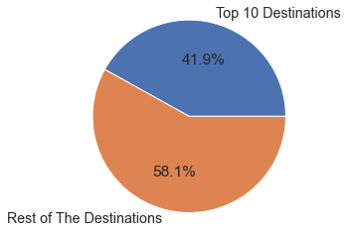
Top 10 Destinations
Top 10 Destinations
1 | ORD | Chicago
2 | ATL | Atlanta
3 | LAX | Los Angeles
4 | BOS | Boston
5 | MCO | Orlando
6 | CLT | Charlotte
7 | SFO | San Francisco
8 | FLL | Fort Lauderdale
9 | MIA | Miami
10 | DCA | Washington
Out of total 105 destinations Top 10 contributes close to 42% of total number of flights

Slide 6
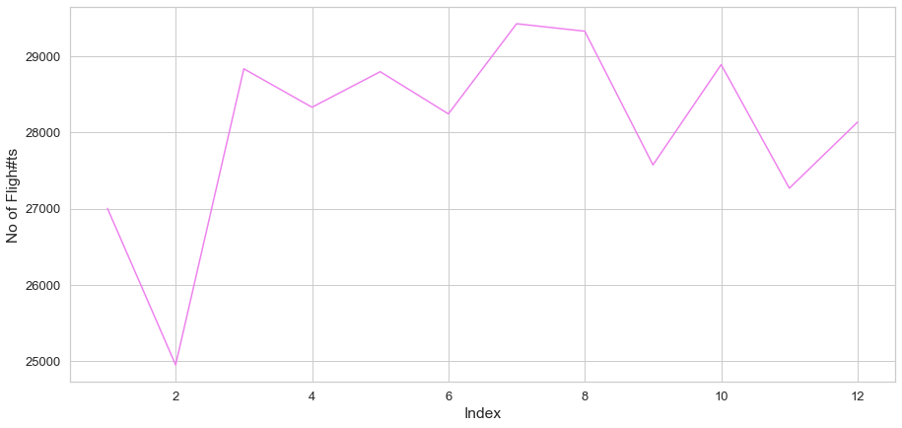
Month wise flight frequency
July & August are the peak months and Feb is low month in flight frequency

Slide 7
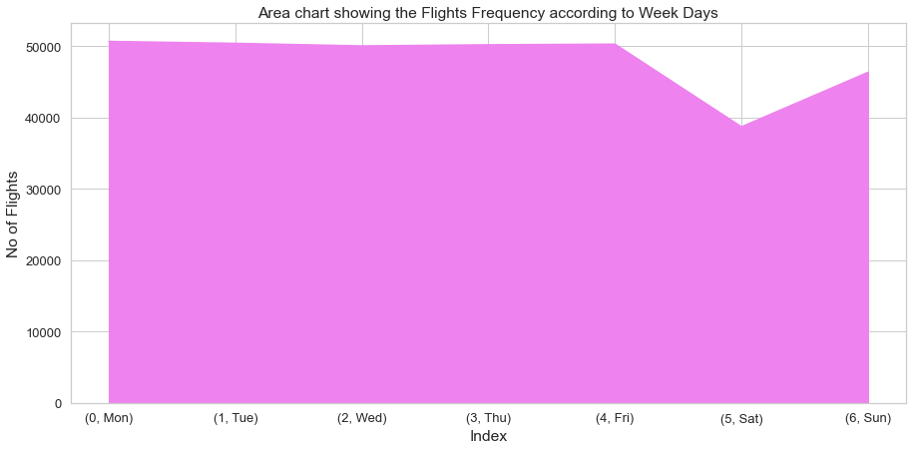
Week days wise flight frequency
Monday to Friday are the most busiest days & and Saturday is low week day in terms of flight frequency

Slide 8
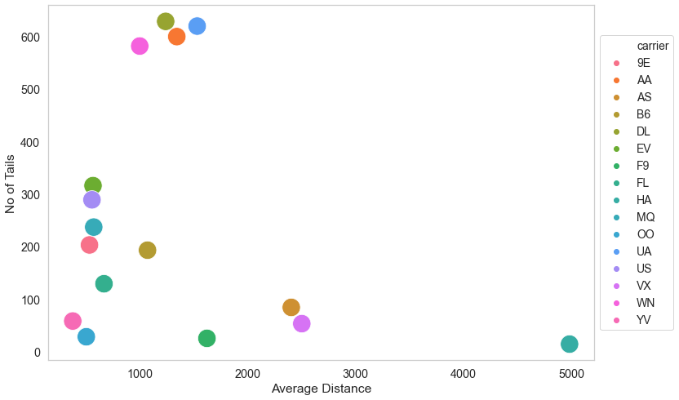
No. of aircrafts and Avg. distance by carriers
VVN (Southwest), EV(EverestJet), UA(United), B6(JetBlue) are the largest airlines with 500 + aircrafts.
MQ , US , 9E , EV ,YV, OO covers short distance routes with avg. distance around 500 Kms.
HA has least aircrafts with longest distance, other long distance carriers are Alaska & Virgin America.

Slide 9
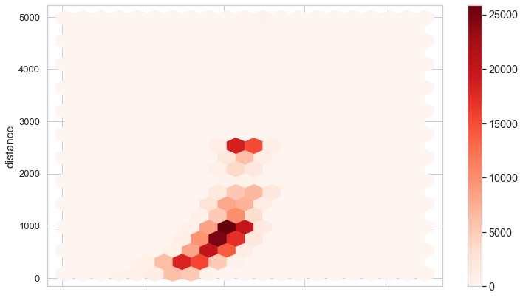
Speed & Average distance by No. of flights
Maximum No. of flights covering distance of 1000 Kms range
Speed is direct proportionate to the distance

Slide 10
DELAY ANALYSIS

Slide 11
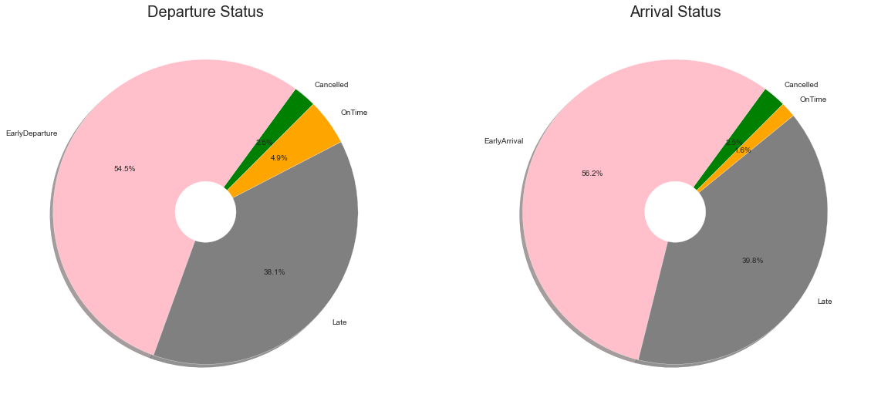
Departure & Arrival Time Analysis
Out of 336776 scheduled flights, 59.4% flights are departed on time or early departure time .
38.1% were delayed and 2.5% of flights were cancelled, 1.7 % flights got delayed inspite of departed on time

Slide 12
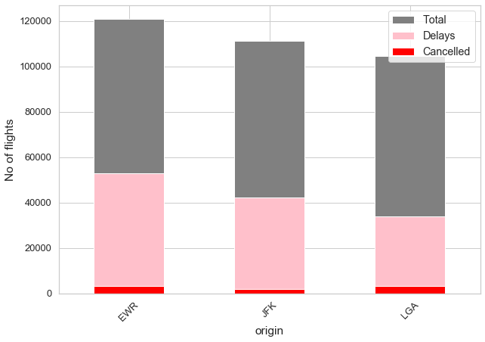
Airport wise delay and cancellation
Airport | Total Flights | Delay | Delay % | Cancel | Cancel %
EWR | 120853 | 52711 | 44 | 3239 | 2.7
JFK | 111279 | 42031 | 38 | 1863 | 1.7
LGA | 104662 | 33690 | 32 | 3153 | 3.0
EWR (Newark Airport) has the maximum delays with 44% of its fights.
LGA(Laguardia) has the maximum Cancellations with 3% of its total flights.

Slide 13
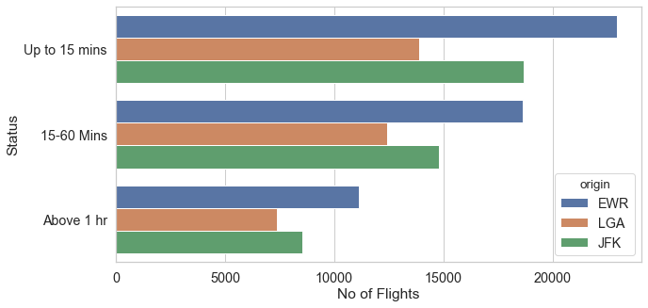
Airport wise Time duration for Departure Delays
Maximum delays are from EWR followed by JFK , LGA is the best Airport for timely departure.
Most of the flights are Delayed between 0-15 mins which might be operational delay .

Slide 14
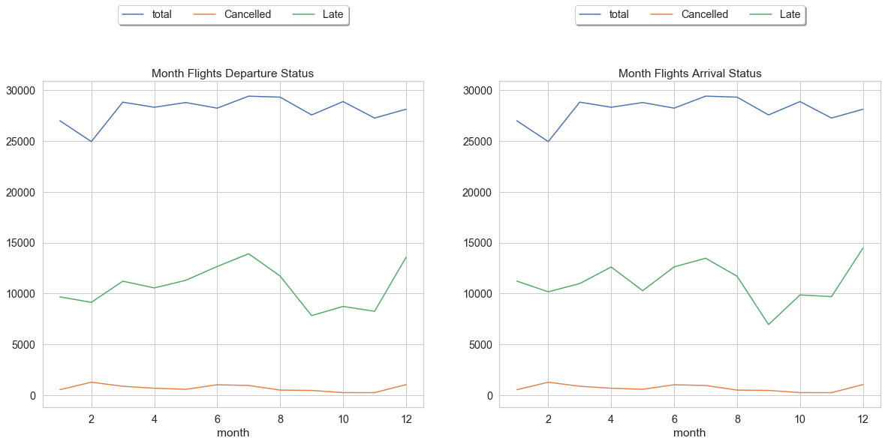
Month-wise delay and cancellation
July & Aug more no. of flights are delayed which could be a Seasonal issue
Sep, Oct & Nov months are the best performing months with less no. of Delays & Cancellation.

Slide 15
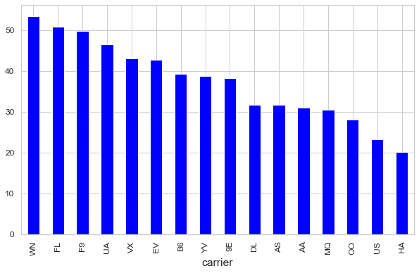
Carriers wise departure delay analysis in % flights
VVN(Southwest) ,FL(Airtran), F9(Frontier) are the Worst Carriers with more than 50% of Delay of its flights.
Other Poor Performing Airlines are UA , VX, EV, B6, YV, 9E, DL, AS, AA, MQ with more than 30 % Delays.

Slide 16
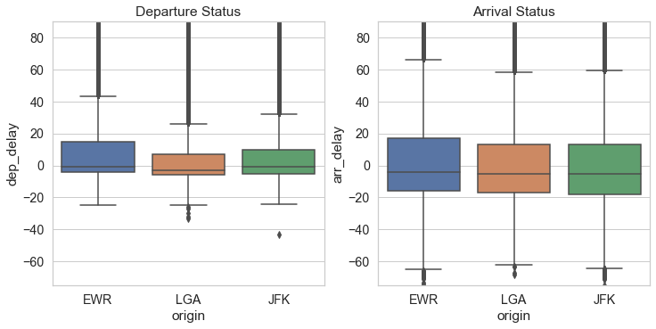
Departure and Arrival delay analysis by frequency
75 to 80 % flights can be on time if Airport manage only short term delays.
There is huge variance in the flight speed resulted either flights are reach very early or further getting late.

Slide 17
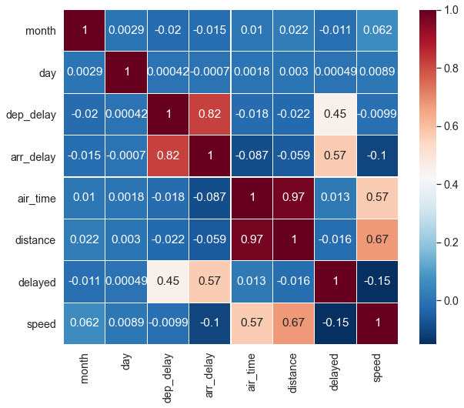
Arr_delay is strongly related to dep_delay. Air_time and distance is also closely related to speed of the flight. Speed is adversely correlated to arr_delay
Departure and Arrival delay analysis by frequency

Slide 18
Conclusion
Overall 40 % flights are either delayed (38.1% ) or cancelled(2.5%).
EWR ( Newark ) is the busiest Airport with 35.9% flights has the maximum delays with 44%.
LGA has the maximum cancellations with 3% followed by 2.7% at EWR.
Total 16 Carriers and 105 Destinations handles 336776 flighs.
Top 3 Carriers UA(United Airlines),B6(Jet Blue) & EV have more than 500 aircrafts and 50 K + flights in a year.
Out of total 105 Total destinations Top 10 contributes close to 42% of total number of flights.
July & August are the peak months with maximum delays as well
Feb has the least no. of flights with more no. of cancellation which could be due to less passengers.
Sep, Oct & Nov months are the best performing months for timely flights and less no. of cancellation.
Out of 38 % delayed flights more than half are less than 15 or 20 mins .
VVN, FL, F9 , UA , VX , EV are Top 5 carriers with close to 50 % delay impacting other flight schedules as well.
Arrival delay is strongly related to Departure delay but variance in the speed and air time further impacts the delay or early arrival.
9E , AA , B6 , DL , EV , MQ have flights from all the three Airports.
High speed aircraft may compensate short delays upto 15 minutes .

Slide 19
Actionable Insights
0-15 minutes to be addressed first
Ease down pressure on Newark by shifting small carriers to LaGuardia
Airlines having multiple Airports to consolidate to 1 or 2.
High speed aircrafts to be used in peak season .
Stringent Clause for Airlines and ground staff to minimize avoidable delays due to operational glitches.
Outcome : With above actions we can improve the passenger experiences with 40 % improvement in timely flights and huge savings on operational costs and penalties for Carriers.

Slide 20
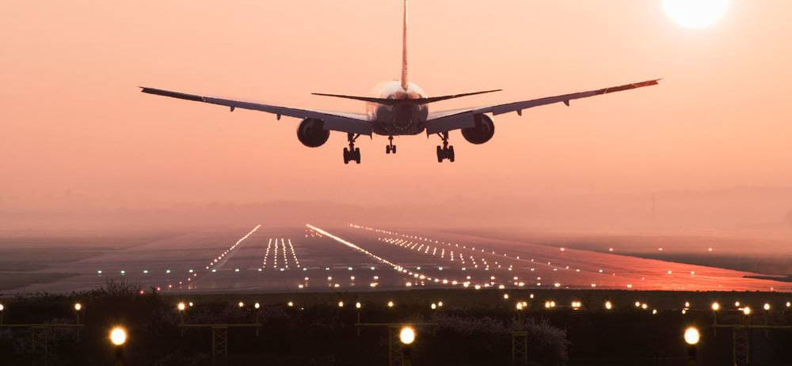
Thanks

